Slide 1
POLITICAL JUGGERNAUTS: A QUANTATIVE ANALYSIS OF CANDIDATES IN THE 2019 LOK SABHA ELECTIONS

Slide 2
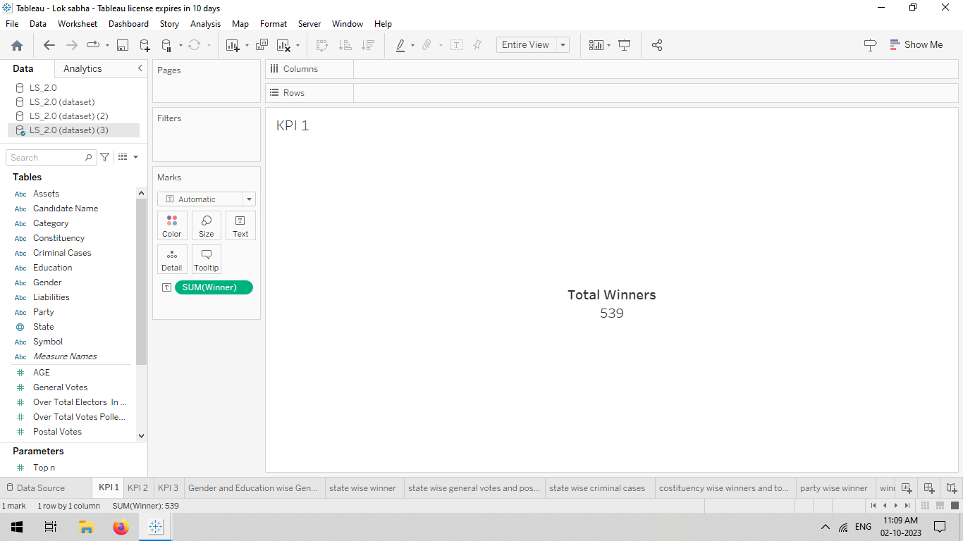
KPI’s 1

Slide 3
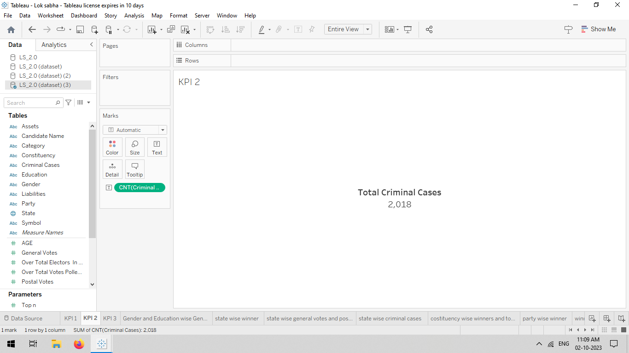
KPI’S 2

Slide 4
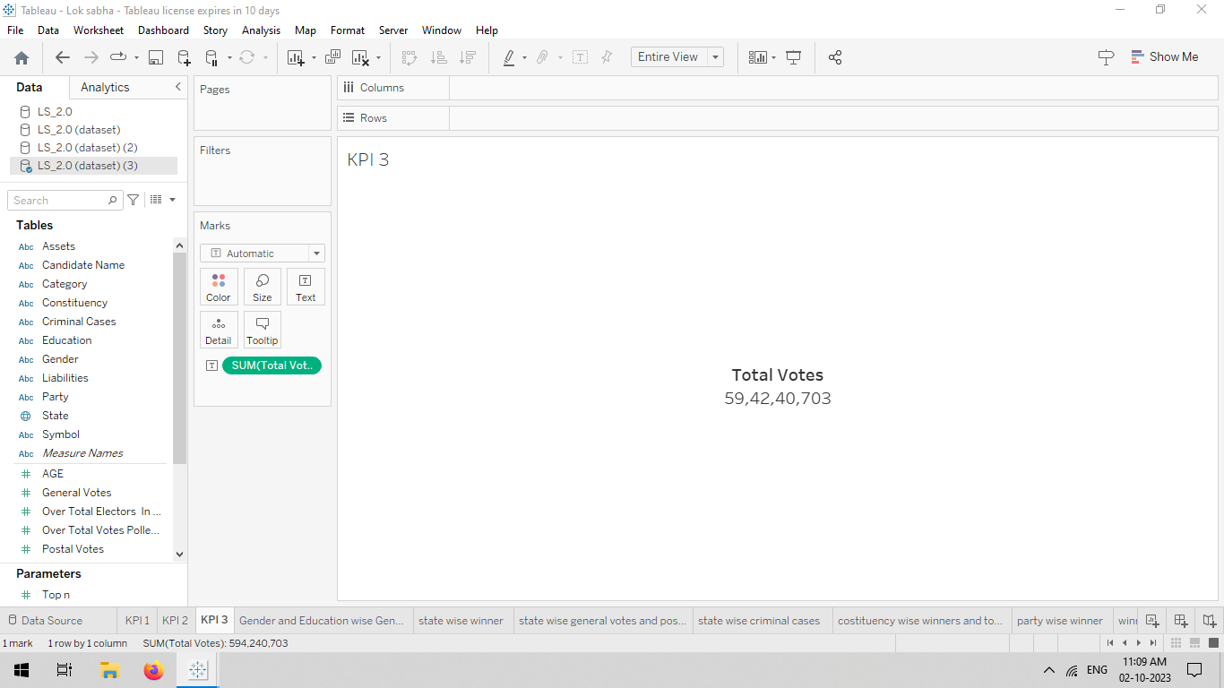
KPI’S 3

Slide 5
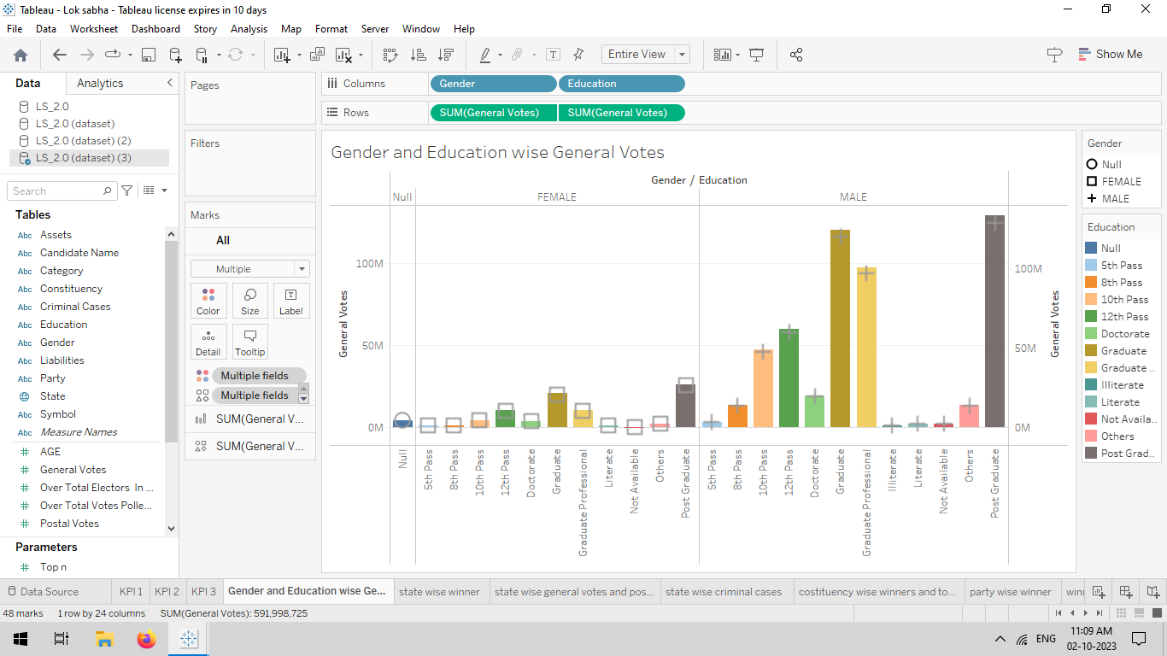
GENDER & EDUCATIONAL WISE GENERAL VOTES

Slide 6
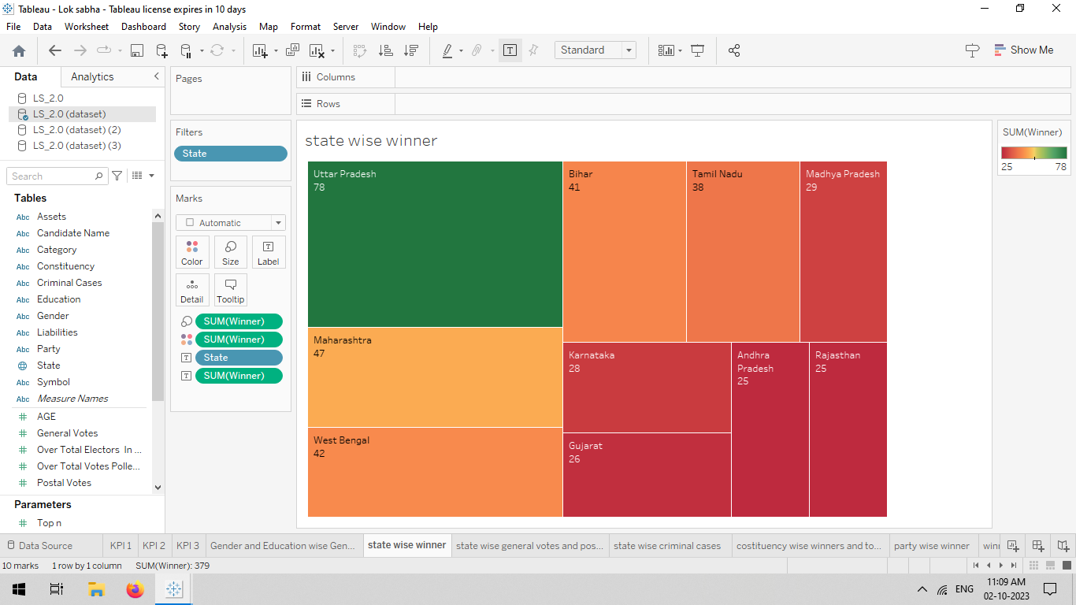
STATE WISE WINNER

Slide 7
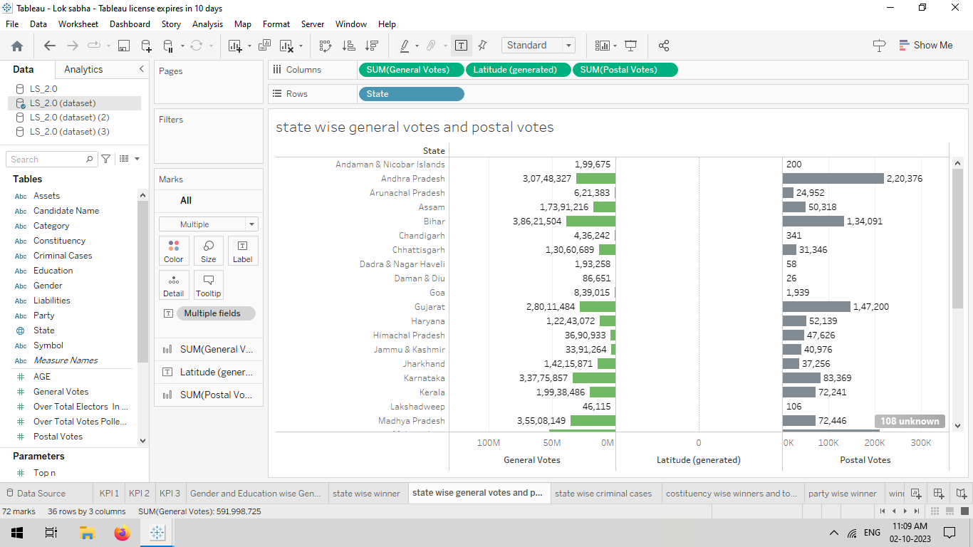
STATE WISE GENERAL VOTES AND POSTAL VOTES

Slide 8
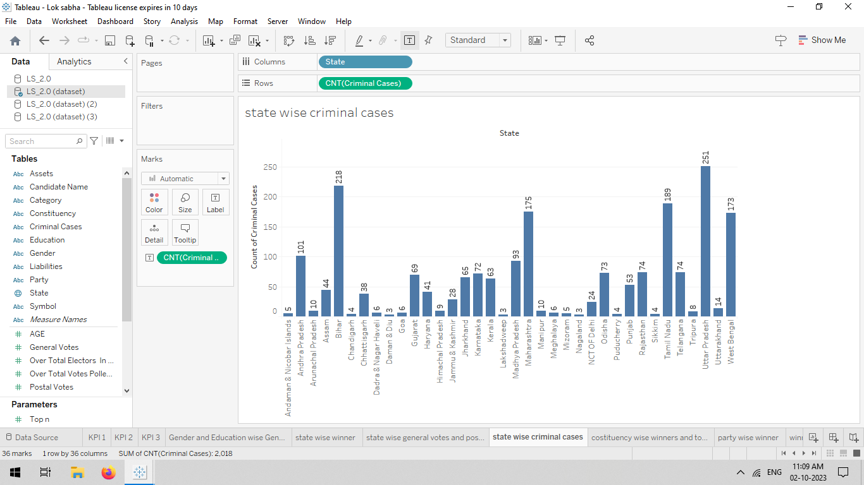
STATE WISE CRIMINAL CASES

Slide 9
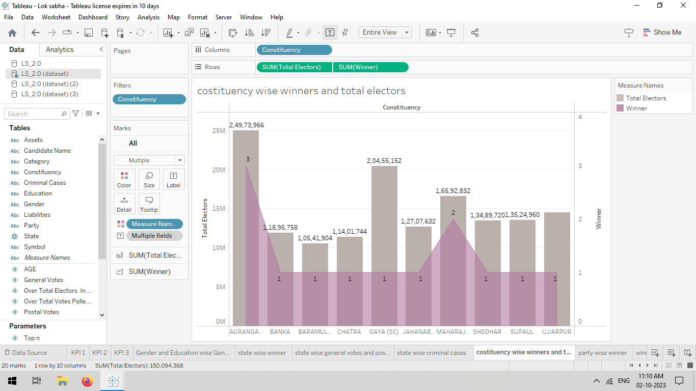
CONSTITUENCY WISE WINNERS AND TOTAL ELECTORS

Slide 10
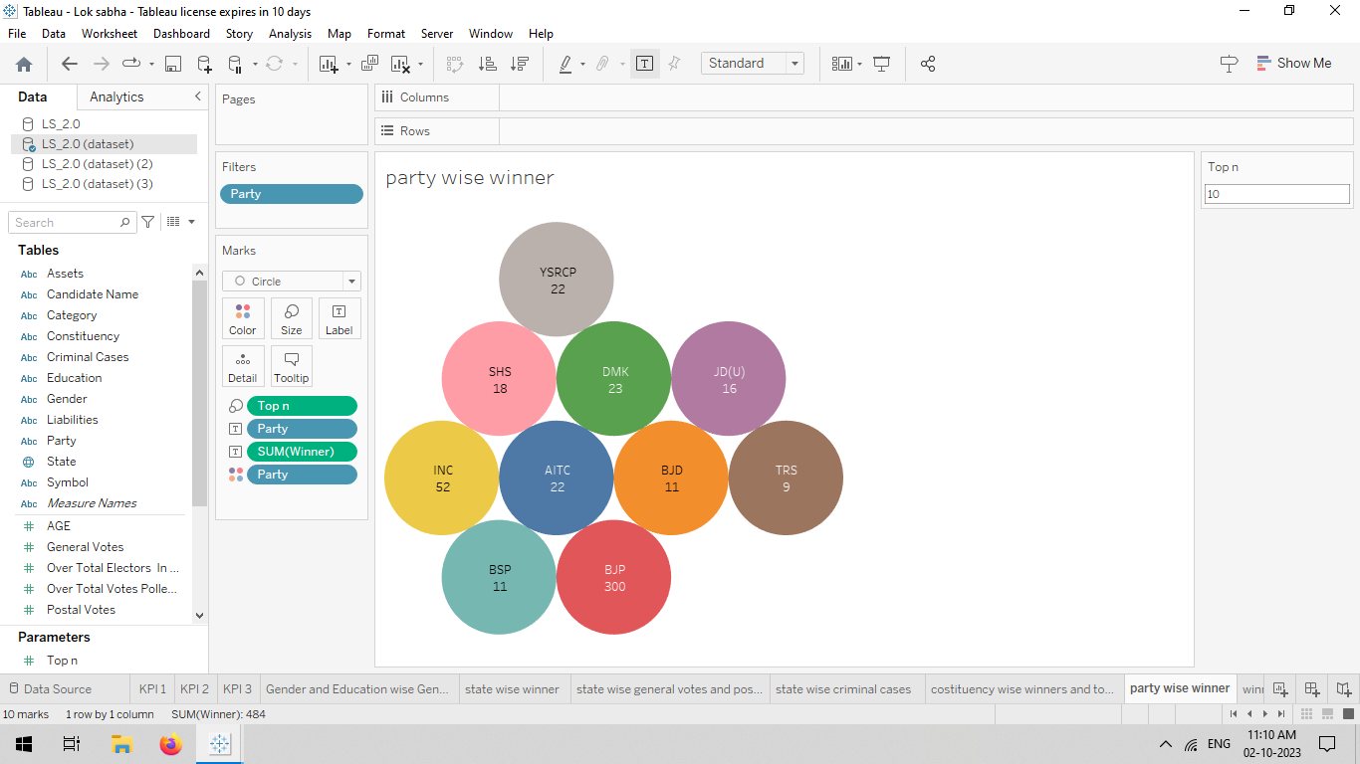
PARTY WISE WINNERS

Slide 11
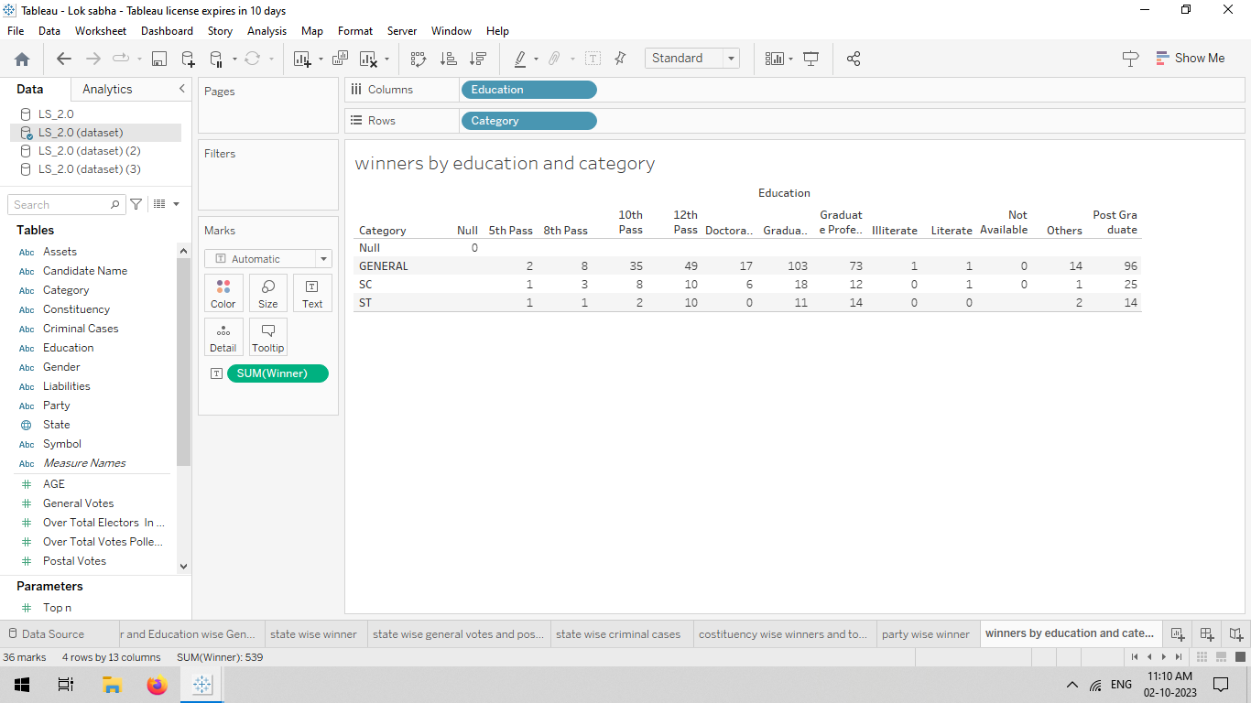
WINNERS BY EDUCATION AND CATEGORY

Slide 12
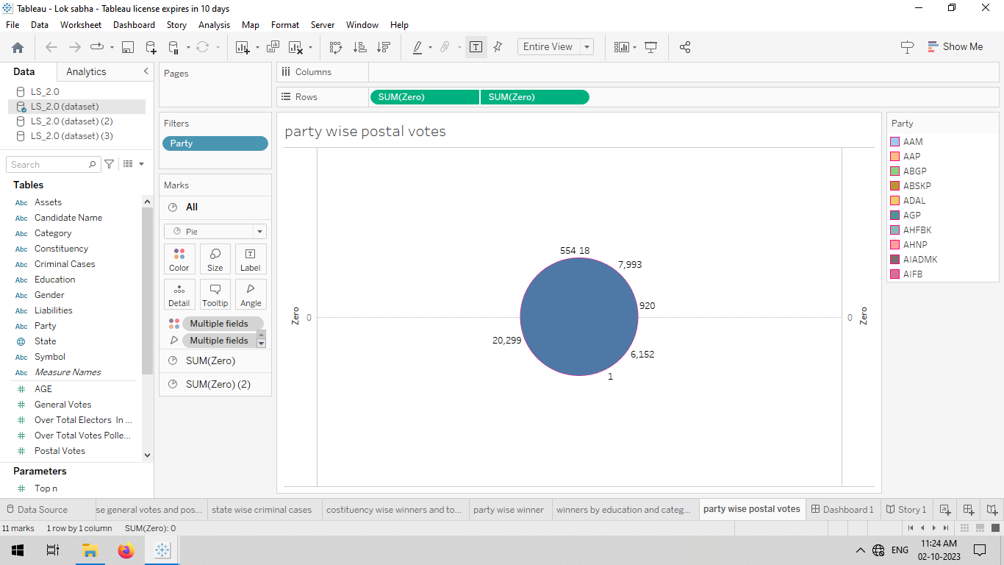
PARTY WISE POSTAL VOTES

Slide 13
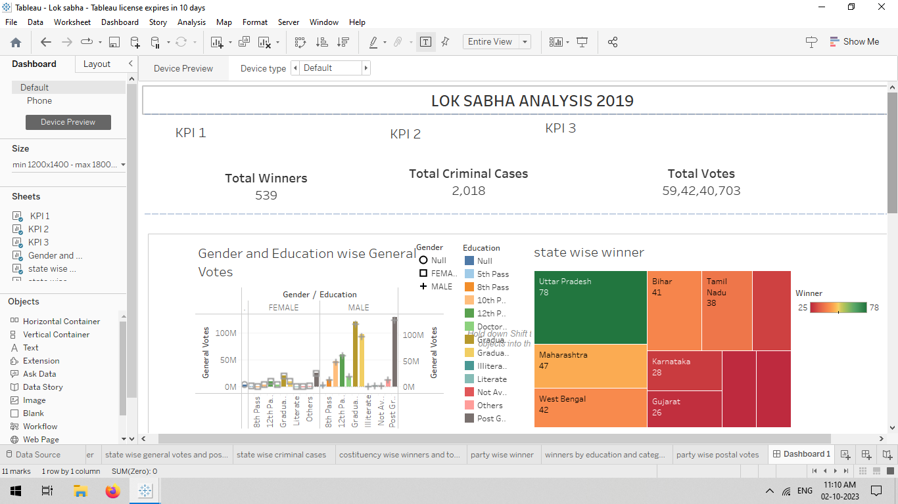
DASHBOARD 1

Slide 14
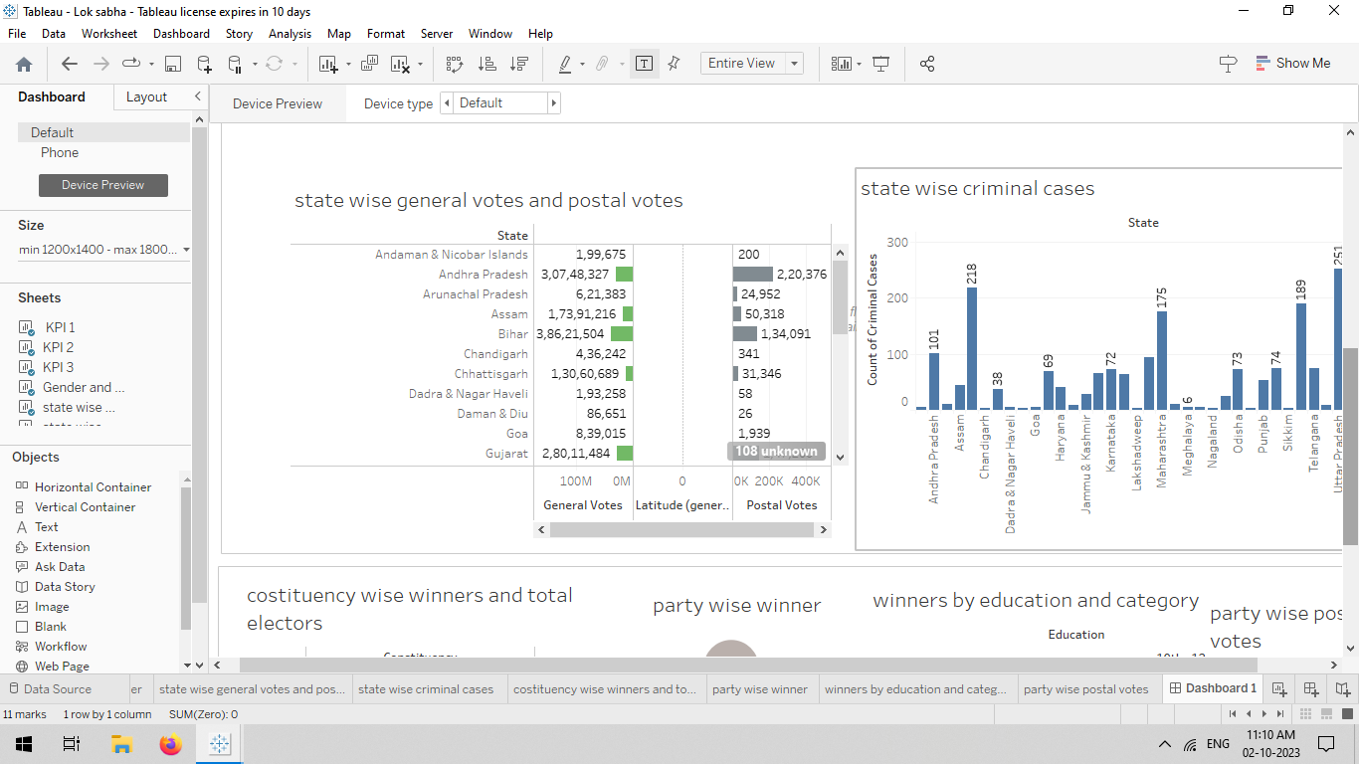
DASHBOARD 2

Slide 15
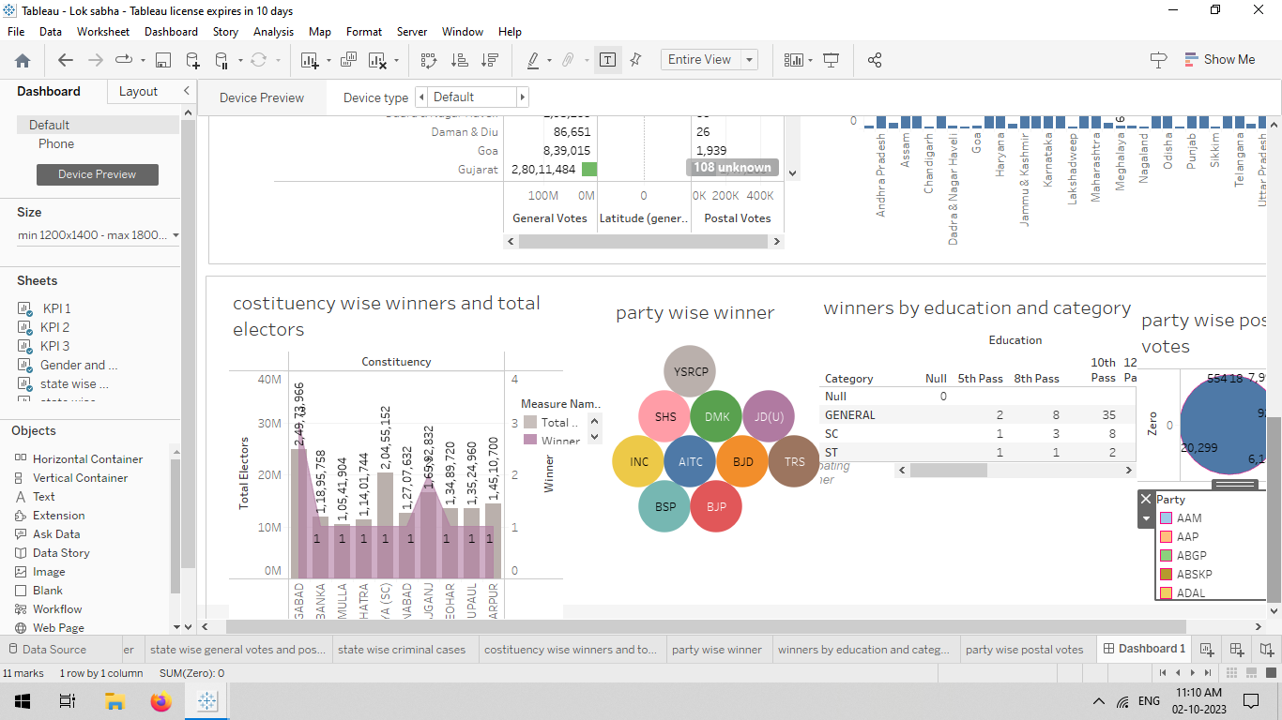
DASHBOARD 3

Slide 16
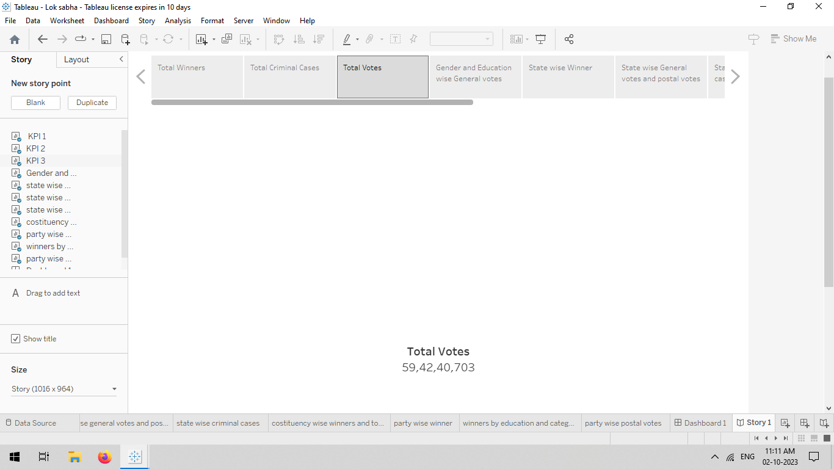
STORY 1

Slide 17
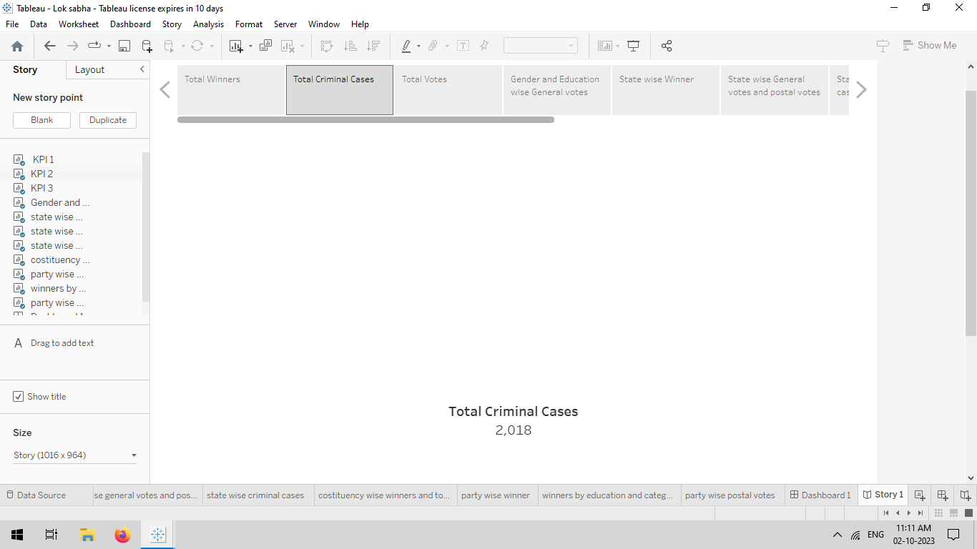
STORY 2

Slide 18
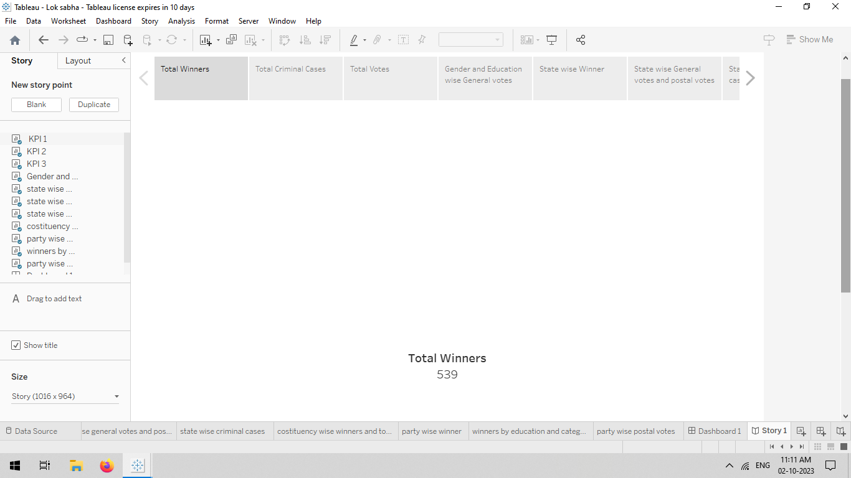
STORY 3

Slide 19
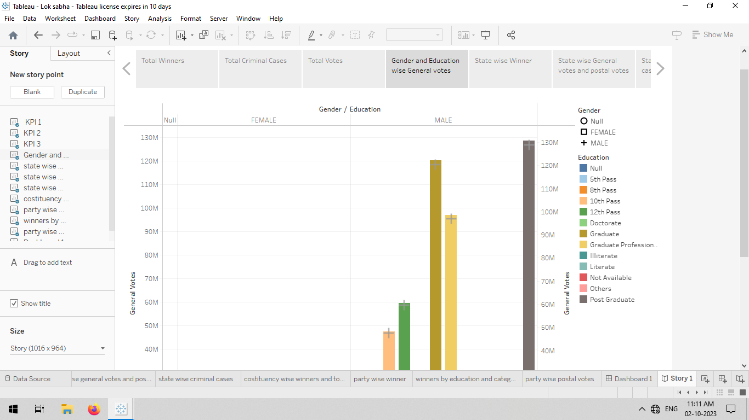
STORY 4

Slide 20
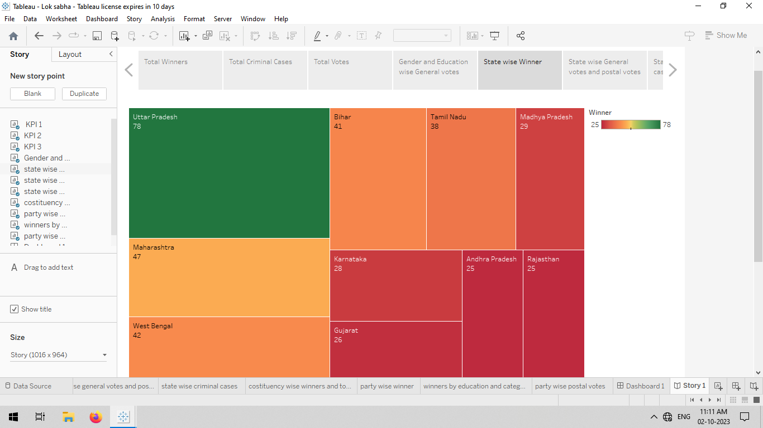
STORY 5

Slide 21
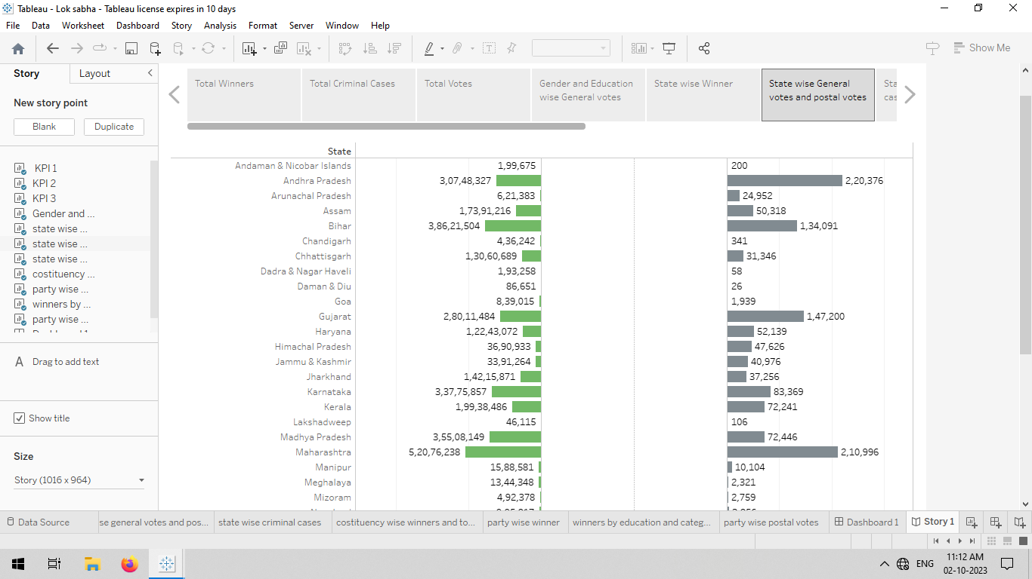
STORY 6

Slide 22
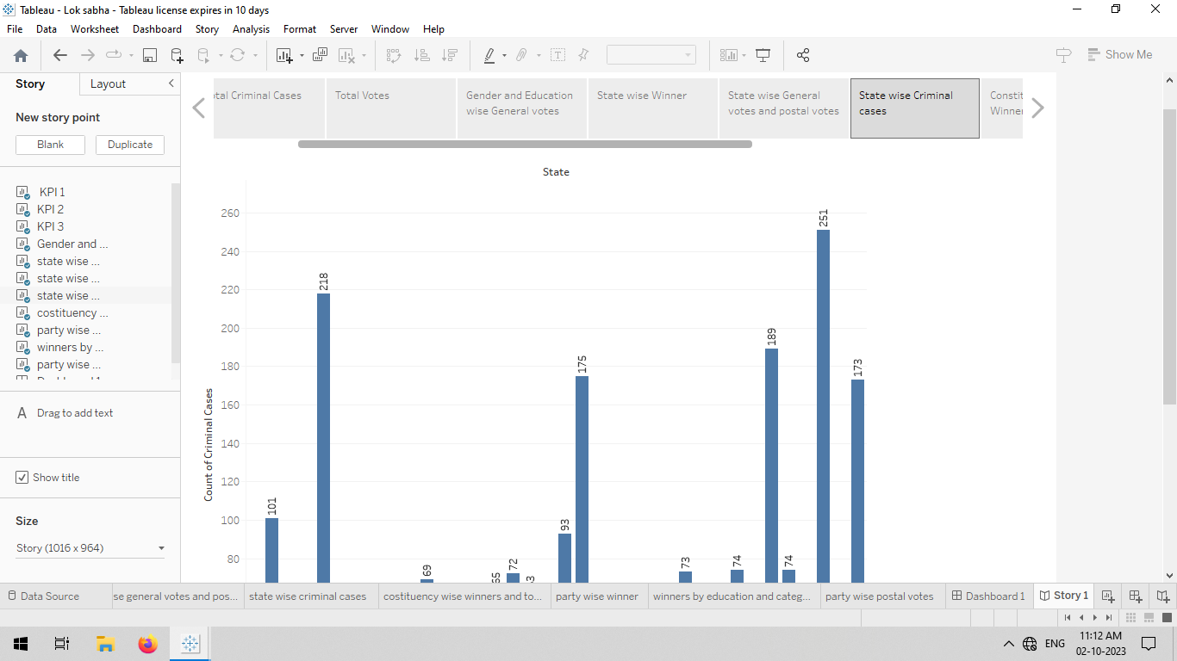
STORY 7

Slide 23
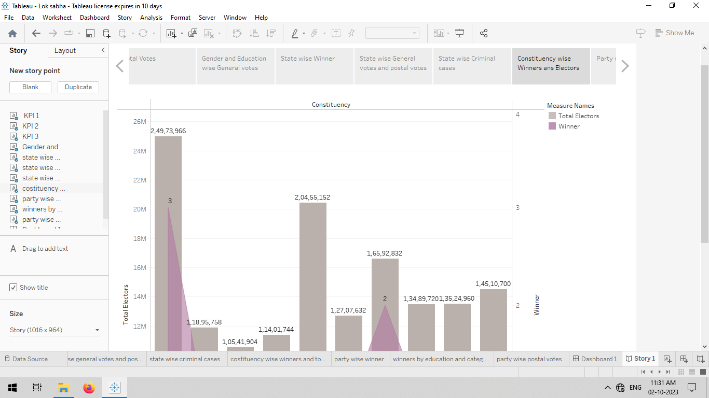
STORY 8

Slide 24
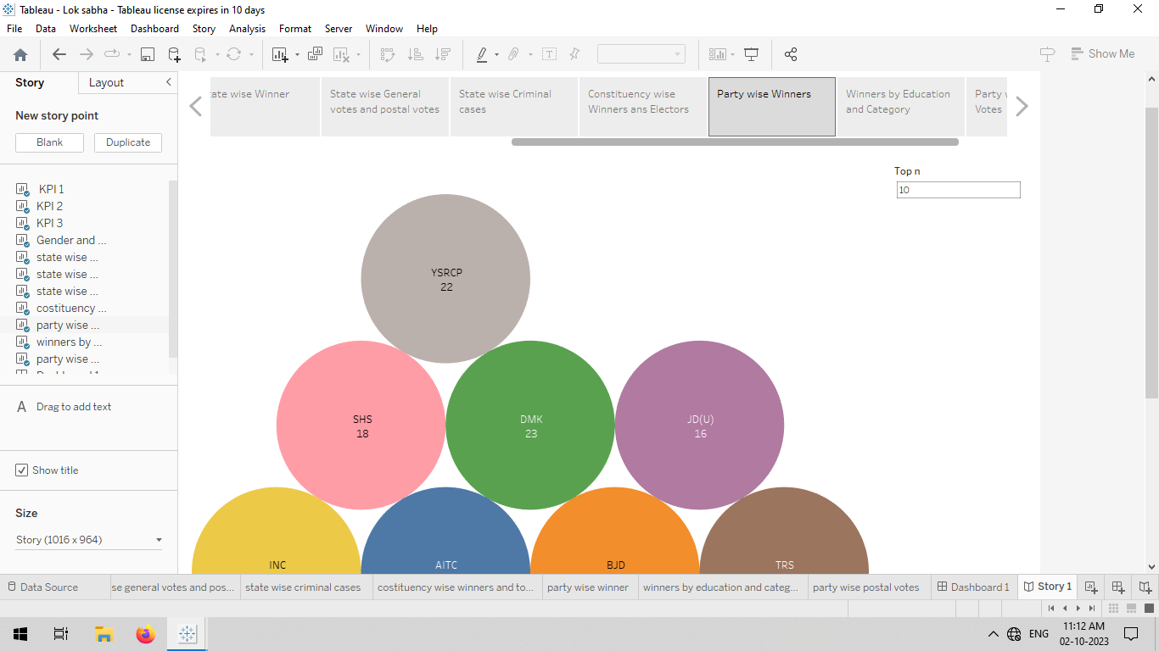
STORY 9

Slide 25
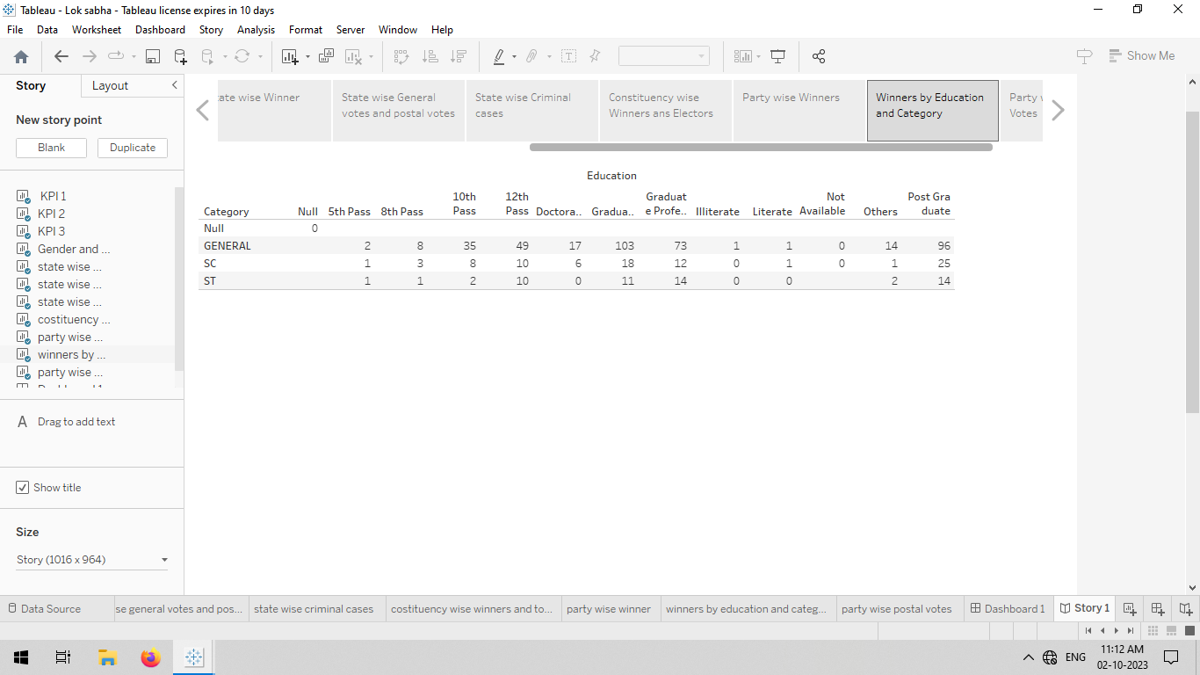
STORY 10

Slide 26
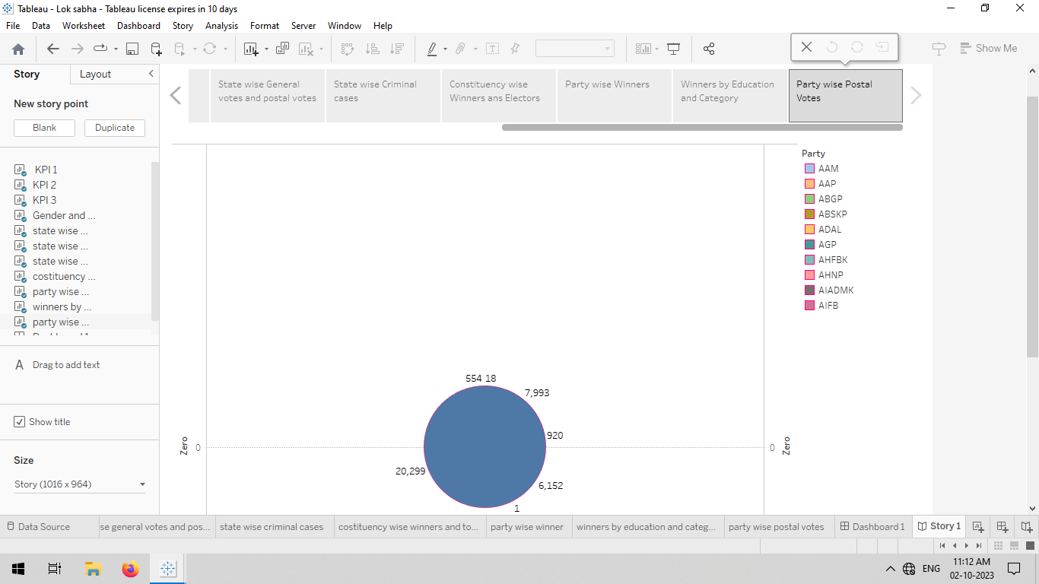
STORY 11

